Slide 1
New York Stocks Analysis

Slide 2
Agenda
Problem Definition
Motivation
Objective
Data
Statistical Analysis
Profit & Loss Statement
Financial Forecasting Model & Sensitivity Analysis
Dashboard

Slide 3
Problem Definition

Slide 4
Problem Definition
Stock​‍​‌‍​‍‌​‍​‌‍​‍‌​‍​‌‍​‍‌​‍​‌‍​‍‌ exchanges are volatile and influenced by a combination of factors, which makes the prediction of price changes and the understanding of the intrinsic value very difficult.
Large volumes of data are generated every day, leading to an enormous information overload. Therefore, it is extremely difficult for them to discover valuable patterns and signals amidst the noise.
Investors identifying risk and possible profit in an objective manner is among the most challenging tasks, as they have cognitive and emotional biases.

Slide 5
Motivation

Slide 6
Motivation
Analysis has the power to unveil trading opportunities that bring in profits. These measures are consistent with the goals of wealth increment and financial stability assurance.
Understanding market trends is very instrumental in grasping the overall state of the economy and the condition of the different sectors.
Stock exchange analysis can be a powerful instrument for scenario diversification and for estimating potential losses.

Slide 7
Objective

Slide 8
Objective
Create models which can predict stock prices or market trends in the future. The main rationale for such predictions is to provide a data-driven leverage for making decisions.
Produce insights that can identify an asset being undervalued or overvalued by using both fundamental and technical figures. As a result, investors are given the option to make more informed decisions regarding the buying or selling of assets.

Slide 9
Data

Slide 10
Data
Column | Type | Description
Ticker Symbol | Category | Symbol for the companies
Years | Number | Number of the year
Year | Number | Year
Period Ending | Date | The period of the stocks
GICS Sector | Category | The sector the company is under
GICS Sub Industry | Category | The specific industry within the sector

Slide 11
Data
Column | Type | Description
Total Revenue | Number | The total revenue the company made
Cost of Goods Sold | Number | The costs of selling the goods
Sales, General and Admin | Number | The costs of the sales, general, and admin
Research and Development | Number | The costs of research and development
Other Operating Items | Number | The costs of other operations

Slide 12
Statistical Analysis

Slide 13
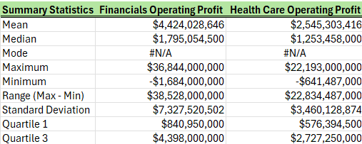
Statistical Analysis
Financial Sectors average operating profit (~4.4B$) is much higher than the average operating profit of Health Care sectors (~2.5B$), with 76% increase in the average operating profit.
This indicates on average, Financial sectors are more profitable.

Slide 14
Statistical Analysis
Financial sectors are much more volatile than Health Care sectors as Financial sectors standard deviation (~7.3B$) which is more than 2x the standard deviation of Health Care sectors (~3.5B$).
This shows that Financial sectors are much more volatile, therefore riskier to invest in.

Slide 15
Statistical Analysis
Financial sectors have a wider range of profit, and it comes at the cost of a larger maximum loss (-1.7B$) in comparison with the Health Care sectors (-641M$)
This shows that Financial sectors have a high reward on investment but with greater risks.

Slide 16
Profit & Loss Statement

Slide 17
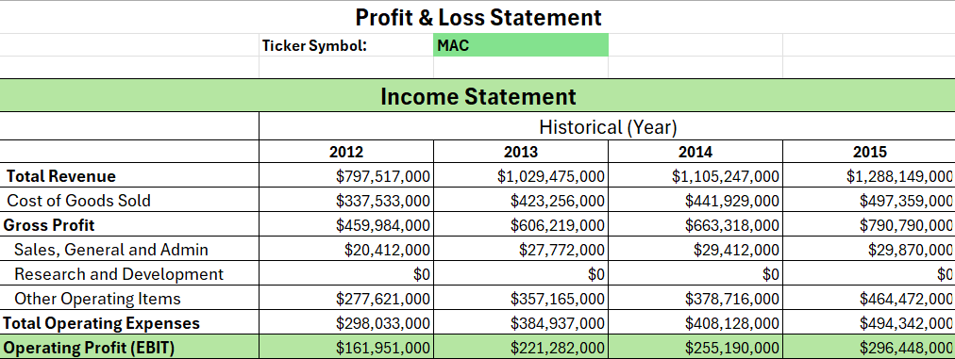
Profit & Loss Statement
The user can select the company they want to view the profit and loss statement for, by selecting the desired Ticker Symbol.
It shows the EBIT, Revenue, and Costs throughout the years.

Slide 18
Financial Forecasting Model & Sensitivity Analysis

Slide 19
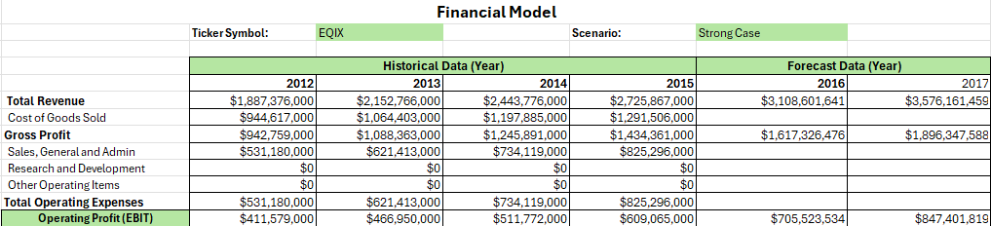
Financial Forecasting Model & Sensitivity Analysis
By selecting the desired Ticker Symbol and the scenario for prediction, as the model predicts after 2 years.
The user can view the company’s profit and loss statement for the historical data for 4 years and 2 years in the future.

Slide 20
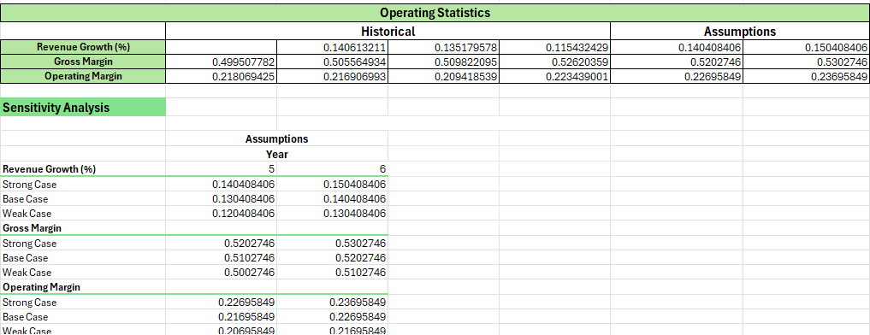
Financial Forecasting Model & Sensitivity Analysis
The screenshot highlights the different scenarios as well as the operating statistics that determine the forecasting model.

Slide 21
Financial Dashboard

Slide 22
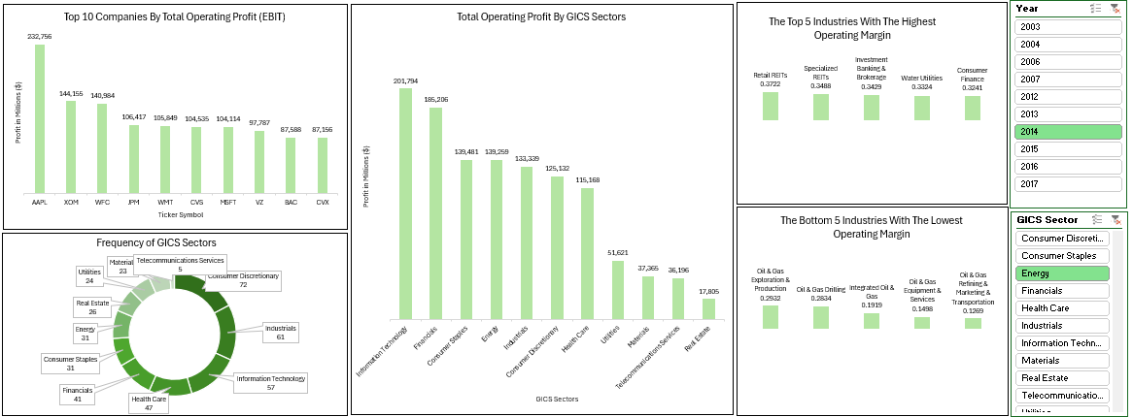
Financial Dashboard
The user can filter through the data if they choose to focus on specific sectors or years.

Slide 23
Thank you

